Slide 1
Final Presentation:
Wikipedia Toxic Comments Classification
Team: Amira Bendjama, Nikhil Muthuvenkatesh, Seyi Oyesiku, Connor Roth

Slide 2
Project Overview
1

Slide 3
Project Goal and Task Description
Project Goal: Develop model to detect and classify different types of toxic comments
Task Description: Text-based classification
Binary Classification: “toxic” versus “non_toxic”
Multi-Label Classification: “toxic”, “severe_toxic”, “obscene”, “threat”, “insult”, “identity_hate”

Slide 4
Dataset Overview
2

Slide 5
Wikipedia Toxic Comments Dataset
Dataset Description: Collection of Wikipedia comments labeled by human raters for toxic behavior
Files: train.csv, test.csv, test_labels.csv, and sample_submission.csv
Records: ~150K for Train and Test files
Train.csv Columns: ID, comment_text, toxic, severe_toxic, obscene, threat, insult, identity_hate

Slide 6
Data Preprocessing
3

Slide 7
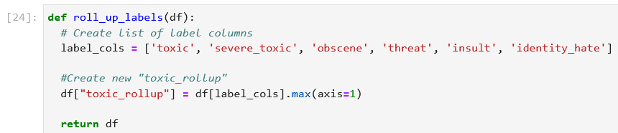
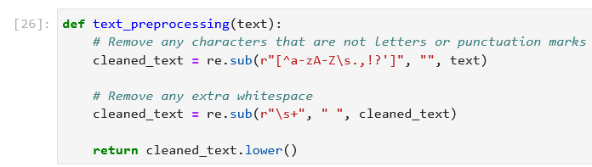
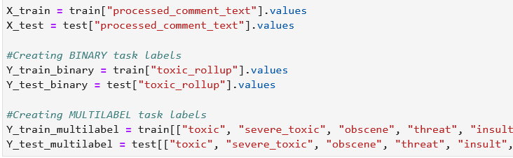
General Preprocessing
Roll up labels for binary classification
Preprocess text (removing certain characters and extra whitespace)
Split into X/Y, Train/Test

Slide 8
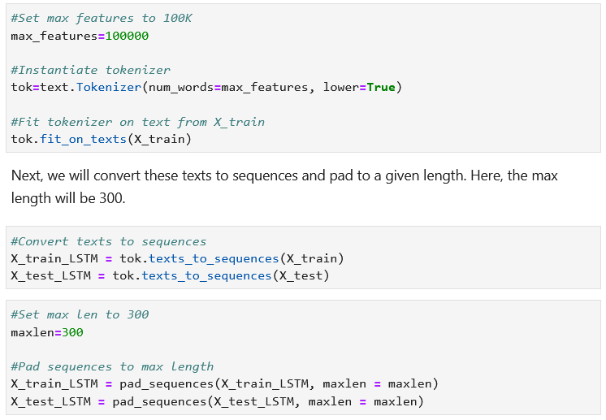
Bi-LSTM Preprocessing
Create tokenizer with max 100,000 features
Fit tokenizer to training dataset
Convert texts to sequences
Pad sequences to max length (300)
Split training set into train/validation (90/10 split)
Convert data to tensors and create Dataloaders

Slide 9
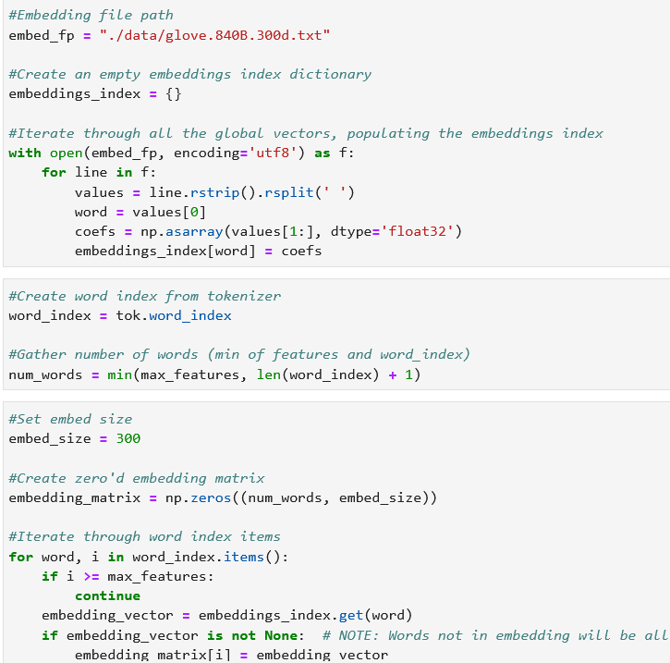
Bi-LSTM Preprocessing (cont’d)
Using GloVe 840B 300d, populate embeddings index
Create embeddings matrix from the collected embeddings

Slide 10
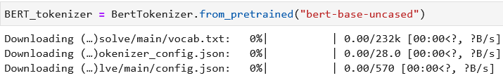
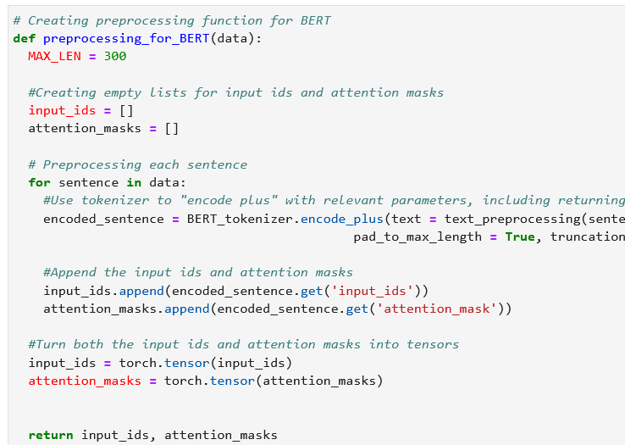
BERT Preprocessing
Download BERT uncased tokenizer
Use “encode_plus” on all sentences within the data
Gather input ids and attention masks
Split training set into train/validation (90/10 split)
Convert data to tensors and create dataloaders

Slide 11
Model Architectures
4

Slide 12
Modeling Overview
Binary Classification
Binary LSTM
Binary BERT
Multi-Label Classification
Multi-Label LSTM
Multi-Label BERT

Slide 13
LSTM: Binary Classification (PyTorch)
Embedding Layer
Relevant parameters for Torch implementation:
Max_length = 300
Embedding_size = 300
LSTM layers = 50
Batch size = 32
Dropout = 0.1
Compiler: Adam optimizer
Loss Function: BCELoss
LSTM Layers
ReLU Activation Layer
Dropout Layer
Linear Layer
Sigmoid Activation Layer (Probabilities)

Slide 14
LSTM: Binary Classification (Keras)
Keras implementation:
Max_length = 300
Embedding_size = 300
LSTM layers = 32
Batch size = 32
Dropout = 0.2
Compiler: Adam optimizer
Loss Function: Binary Cross Entropy
Embedding Layer
LSTM Layers
Dense Layer

Slide 15
LSTM: Multiclass Classification (PyTorch)
Embedding Layer
Relevant parameters for Torch implementation:
Max_length = 300
Embedding_size = 300
LSTM layers = 50
Batch size = 32
Dropout = 0.1
Compiler: Adam optimizer
Loss Function: BCELoss
LSTM Layers
Average Pooling
Max Pooling
Concatenation
Linear Layer (1)
ReLU Activation Layer
Dropout Layer
Linear Layer (2)
Sigmoid Activation Layer (Probabilities)

Slide 16
BERT: Binary Classification (PyTorch)
Binary implementation consists of…
Pretrained BERT (uncased)
Linear layer: receives BERT output
ReLU layer: serves as activation
Linear layer: outputs model’s prediction (logits)
BERT (Pretrained, Uncased)
Linear Layer
ReLU Activation Layer
Linear Layer (Prediction)
Sequential Layers for Classification

Slide 17
BERT: Multilabel Classification (PyTorch)
Architecture for Multilabel is highly similar to Binary, except…
Different out-dimension (6 instead of 1)
Additional Sigmoid activation layer for probabilities
BERT (Pretrained, Uncased)
Linear Layer
ReLU Activation Layer
Linear Layer
Sigmoid Layer (Probabilities)
Sequential Layers for Classification

Slide 18
Model Performance
5

Slide 19
Baseline and Evaluation Criteria
Baseline: Match or exceed best-performing model from paper review
Binary Classification: F1-score of 0.828
Multi-Label Classification: F1-score of 0.872*
Evaluation Criteria: Utilize F1-score and Accuracy as primary metric. Other metrics are included as necessary.
*Note: F1 score obtained by only sampling positive cases, resulting in a boosted score

Slide 20
Binary Classification Task
Bi-LSTM
BERT
KERAS | Train | Val | Test
Accuracy | 0.95 | 0.96 | 0.92
Weighted F1 Score | 0.44 | 0.73 | 0.62
IN PROGRESS
PYTORCH IN PROGRESS

Slide 21
Multi-Label Classification Task
Bi-LSTM
BERT
PYTORCH | Train | Val | Test
Weighted F1 Score | 0.73 | 0.75 | 0.61
toxic | 0.82 | 0.85 | 0.67
severe_toxic | 0.05 | 0.09 | 0.09
obscene | 0.82 | 0.83 | 0.69
threat | 0.00 | 0.00 | 0.00
insult | 0.72 | 0.75 | 0.60
identity_hate | 0.22 | 0.20 | 0.22
IN PROGRESS

Slide 22
Wrap-Up and Questions
6

Slide 23
Thanks!
ANY QUESTIONS?
Contact Information:
Amira Bendjama: ab4745@drexel.edu
Nikhil Muthuvenkatesh: nm3297@drexel.edu
Seyi Oyesiku: so536@drexel.edu
Connor Roth: cxr25@drexel.edu

